Slide 1


Training Workshop Advanced IT Professional Skills
MUHAMMAD TARIQ
(System Analyst, Directorate of IT)

Slide 2


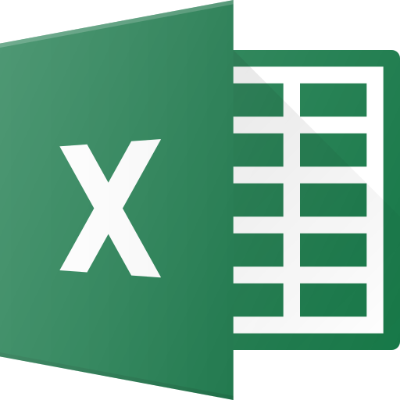

Training: Milestones
Microsoft Word
General Tips
Mail Merge
Microsoft Excel
General Tips
Data Analysis and PivotTables
Charts
PowerPoint
General Tips
Animations
Screen Capture

Slide 3
Training: Milestones
Microsoft Word
General Tips
Mail Merge
Microsoft Excel
General Tips
Data Analysis and PivotTables
Charts
ChatGPT
Integration and Usage
PowerPoint
General Tips
Animations
Screen Capture

Slide 4
Training: Material
For hands-on exercise, the training file are available at
https://github.com/tariq-iub/Training

Slide 5
Microsoft Word
General Tips
Mail Merge
ChatGPT
Tips File
Mail Merge
Demo File

Slide 6

Microsoft Excel
General Tips
Data Analysis
ChatGPT
PivotTable
Open File
Demo File
Analytics

Slide 7
Microsoft Excel
Charts
A picture speaks 1000s of words
Visual representations of data that can help to analyze and understand the information.
Used to show trends, comparisons, and relationships between different sets of data.

Slide 8
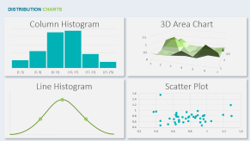
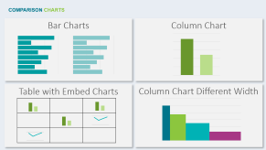
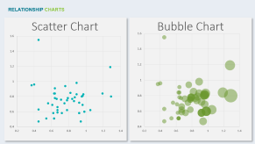
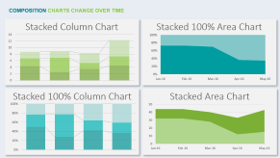
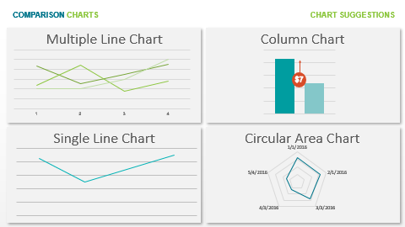
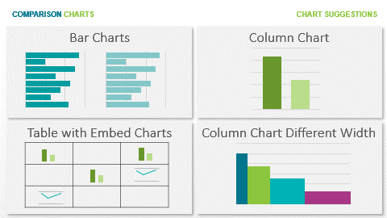
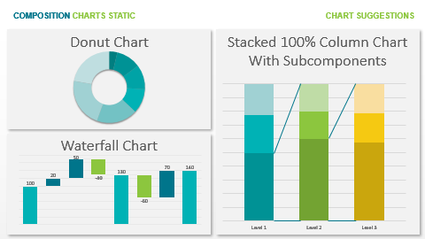
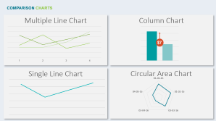
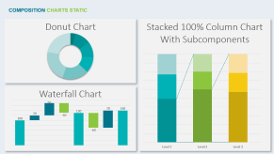
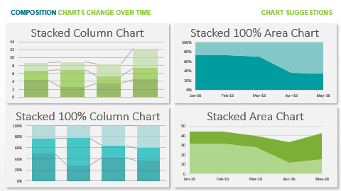
Many Items
Few Items
Many Categories
Few Categories
Few Categories
Many Periods
Among Items
Over Time
Many Categories
Few Periods
Two Variables
Non-Cyclical Data
Cyclical Data
Many Categories
Three Variables
COMPARISON
Three Variables
Few
Points
What would you like to show?
RELATIONSHIP
DISTRIBUTION
Single
Variable
Many
Points
Two
Variables
COMPOSITION
Two
Variables
Few Periods – Relative and Absolut Difference
Relative Difference
Simple
Share of Total
Change over time
Static
over
time
Many Periods
Relative and Absolut
Difference
Accumulation
Subst. of Total
Components of Components
Few Periods – Relative Difference

Slide 9
RELATIONSHIP CHARTS
Scatter Chart
Bubble Chart

Slide 10
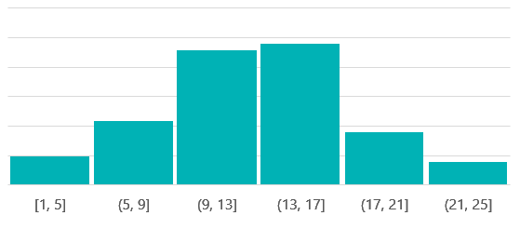
DISTRIBUTION CHARTS
Column Histogram
3D Area Chart
Line Histogram
Scatter Plot

Slide 11
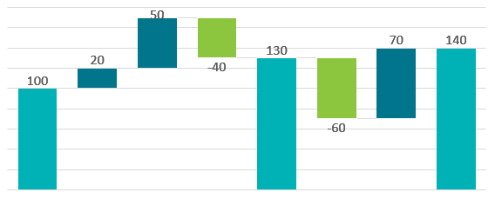
COMPOSITION CHARTS STATIC
Donut Chart
Stacked 100% Column Chart With Subcomponents
Waterfall Chart

Slide 12
COMPOSITION CHARTS CHANGE OVER TIME
Stacked Column Chart
Stacked 100% Area Chart
Stacked 100% Column Chart
Stacked Area Chart

Slide 13
COMPARISON CHARTS
Multiple Line Chart
Column Chart
$7
Single Line Chart
Circular Area Chart

Slide 14
COMPARISON CHARTS
Bar Charts
Column Chart
Table with Embed Charts
Column Chart Different Width

Slide 15
RELATIONSHIP ADDITIONS
Flow Chart
Hierarchy
Networks
Quadrants

Slide 16
Microsoft Excel
Bubble Chart Demo
Open File

Slide 17
Microsoft PowerPoint
General Tips
Animations
Screen Capture
Designer
Zoom
Cameo
ChatGPT to PPT
Transitions
Morph
Pan
Animations
Grow/Shrink
From Insert Tab
From Record Tab
Using HandBrake

Slide 18
It is a Q&A Session
Do you have any questions, please?
We need your feedback!

Slide 19
Thank You
For Your Time

